Slide 1
www.health.gov.lk
See your health care. One step at a time.

Slide 2
How to use
Preview version of the website may function normal as a website within the keynote preview, navigate the site as required.
Prototype will include prefilled fields and static data to make the experience more comfortable for you.

Slide 3
Loading
Loading…

Slide 4
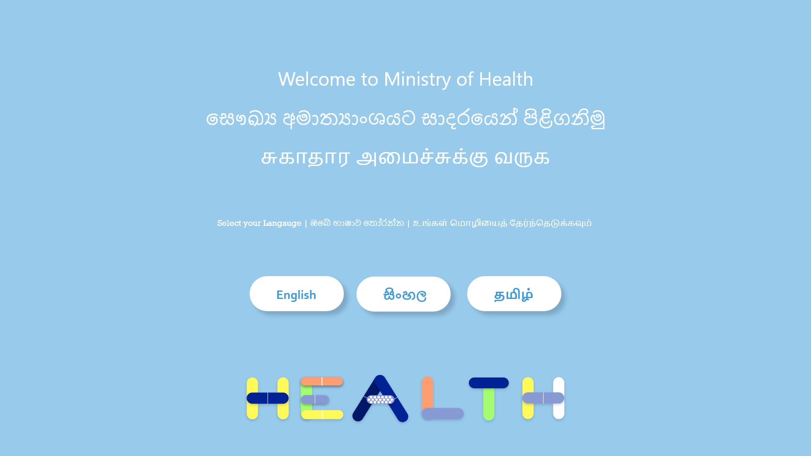

Slide 5

Home - English

